Slide 1

Mentoring and
Training
Chapter 4

Slide 2
Learning occurs as a result of ______________ and _______________, and can occur in any of three general dimensions or domains known as:
1. The _______________domain
The _______________domain
The _______________domain
practice
experience
cognitive
affective
psychomotor
Notes:
Page 78-79

Slide 3
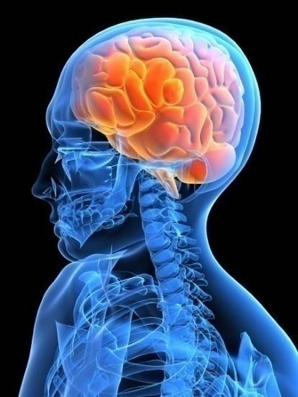
Bloom’s Taxonomy
Q: What is Bloom’s Taxonomy?
A: A learning theory that
illustrates a hierarchy of five
learning outcomes included in the cognitive domain.
Notes:
Page 78
What are the five learning outcomes included in the theory?

Slide 4

Bloom’s Taxonomy
Evaluation
Synthesis
Application
Comprehension
Basic Knowledge
Notes:
Page 78
Note—As you study for this exam, challenge yourself to study the material at the evaluation level. The deeper you know, understand and can apply and evaluate the information, the more likely it is that you will be able to successfully answer questions on the exam.

Slide 5
Apply Bloom’s Taxonomy to
Learning a New Computer Program
Basic Knowledge
Defining Specific terms and principles
Reciting specific facts and rules
Matching concepts with explanations
Comprehension
Explaining facts and principles
Interpreting charts and graphs
Predicting future consequences implied in data
Application
Distinguishing between facts and inferences
Explaining the relevance of data
Analyzing the major causes of a problem
Synthesis
Composing a musical score
Designing a comprehensive plan to solve a problem
Revising sections of a chapter
Evaluation
Discriminating between the findings of two research studies
Summarize the highlights of a report
Judging the value of a work by using externally established standards of excellence

Slide 6

Affective Domain
emotions
feelings
Learning indicated by __________, __________, or ___________.
expressions
Why should trainers devote more attention to the affective domain in various learning activities and techniques?

Slide 7

Psychomotor Domain
Learning is expressed by the actual _____________, of specific acts and the capability of operating equipment and technology by moving and manipulating various levers and devices.
Why might it be important to include all three domains in training?
performance

Slide 8
Learning Theories
Pavlov’s dog is associated with what learning theory?
Give a brief explanation of the theory.
How have you seen this theory used?
Notes:
Page 79
Classical Conditioning—Stimulus→Response, e.g. Pavlov’s dog.
Classical conditioning refers to the learning that has occurred when a living organism responds to a stimulus that would normally not produce such a response. Learning a conditioned response involves acquiring an association between a conditioned stimulus and an unconditioned stimulus.
“Howdy”

Slide 9
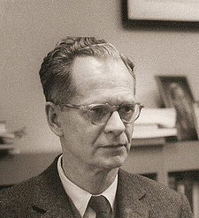
B.F. Skinner is associated with what theory?
What happens if a supervisor only rewards good behavior when he/she has time or only does it for certain employees? What is this result referred to?
Law of contingent reinforcement.
The law of says that a reward must be given as soon as possible after desired behavior occurs to have maximum value.
immediate reinforcement
Notes:
The premise of operant conditioning is that behavior results from its consequences. Also known as the law of effect.
Operant Conditioning (Reinforcement)—Law of effect—Behaviors that are rewarded tend to be repeated, while behaviors that are not reinforced tend to cease.
What happens if a supervisor only rewards good behavior when he/she has time or only does it for certain employees? What is this result referred to? Law of contingent reinforcement.
Also know Law of immediate reinforcement—reward must be given as soon as possible after desired behavior occurs to have maximum value.
What is one key word you can associate with Operant Conditioning? Control.

Slide 10

Cognitive Learning
Cognitive→Brain→Thinking
The cognitivist paradigm essentially argues that the “black box” of the mind should be opened and understood. The learner is viewed as an information processor (like a computer).

Slide 11
Social Learning
Social Learning (Observational learning)—People can learn by observation and direct experience.
  Involves role and behavioral modeling by observing and following the actions of others.
  Four process involved in social learning—attention, retention, reproduction, and motivation.
Notes:
Page 80
Attention, retention, reproduction, and motivation—In brief, these processes involve the ability to pay attention to a behavior to be imitated; the ability to retain (remember and recall) the behavior; the ability to reproduce the behavior physically; and the desire that results in motivation to perform the behavior.

Slide 12
Questions for Deeper Understanding of Learning Theories
What are some examples of learning experiences using the different theories?
What are the potential benefits and drawbacks of each theory?
Notes:
Potential drawbacks: 1) May not be a person’s preferred way of learning; and 2) Would need to have an appropriate model to learn from.

Slide 13
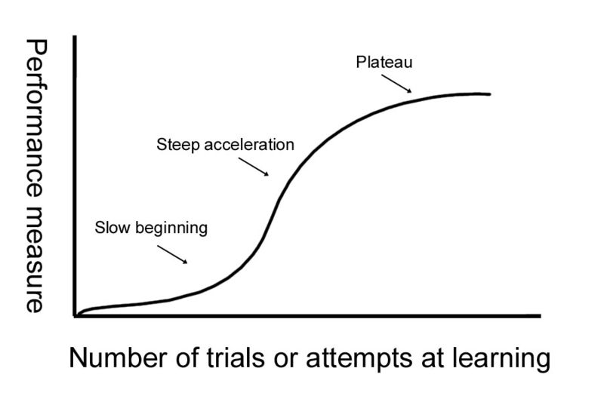
Explain the Graph Below
Notes:
Learning Curve
A graph that depicts rate of learning, especially a graph of progress in the mastery of a skill against the time required for such mastery.
Changes in behavior occur only after repeated practice.

Slide 14

A person’s preferred way of taking in and processing information is known as a
Learning Style
What kinds of methods can you use to teach people whose preferred learning style is:
Concrete Experience
Reflective Observation
Abstract Conceptualization
Active Experimentation
Notes:
What kinds of methods can you use to teach people whose preferred learning style is:
Concrete experience (direct involvement in experiences and dealing with human situations in a personalized manner)—case studies, hands-on kinds of experiences that deal with human situations in a personalized manner.
Reflective Observation (focus on understanding the true meaning of ideas and situations through careful observation, reflection, and description) —shadowing
Abstract conceptualization (focus on the use of logic, ideas, and concepts and are able to excel in systematic planning, quantitative analysis, and manipulation of abstract symbols while solving problems) —problem solving activities
Active Experimentation — (concerned primarily with influencing people and changing situations) Close to concrete experience—trial and error, learn by doing.

Slide 15




Questions for Deeper Understanding of Learning Styles
What is your preferred learning style? What does this mean for you as a learner?
Can you think of examples of people who fit each learning style?

Slide 16
What are the two preconditions for learning?
Learner readiness—Must have foundational learning in order to grasp new content.
Learner motivation—Comes from within. Should have frustration tolerance (ability to persist even when learning is difficult) and self-efficacy (a belief in your ability).
Notes:
Page 81

Slide 17
For training to be effective what are the other prerequisites for learning?
Career plans
Realistic training preview
High expectations for learning—self efficacy
How might these affect learning?
Notes:
Page 81-82
Career plans—students with definite career plans are more likely to learn than persons who are undecided about future directions.
Realistic training preview—learners who have unrealistic expectations about themselves (e.g. effort required of them) or the program, may not benefit from the program.
High expectations for learning—self efficacy

Slide 18
How can you ensure that learners master new knowledge, skills and abilities?
Apply General Learning Principles
  Feedback
  Reinforcement—Why is intermittent reinforcement sometimes more effective than Continuous reinforcement?
    Continuous Reinforcement
    Intermittent Reinforcement
  Practice
    When would you encourage whole versus part learning? (mail sorting vs. computer skills)
    When is massed practice appropriate? When is spaced practice more appropriate?
    How do you know when you have overlearned something?
  Transfer of Learning
  Relevance of Material
  Conditions for Learning
Notes:
Page 81-84
Feedback—whether positive or negative is necessary to maintain motivation for continued learning
Reinforcement (operant conditioning)—Why is intermittent reinforcement sometimes more effective than Continuous reinforcement? Learners do not know when or how they will be tested or observed and thus are more vigilant at all times.
Continuous Reinforcement
Intermittent Reinforcement
Practice
When would you encourage whole versus part learning? (mail sorting vs. computer skills)
When is massed practice appropriate? When is spaced practice more appropriate? Massed—simple tasks; spaced—more difficult tasks.
How do you know when you have overlearned something?
Transfer of Learning—The entire purpose of learning is to change behaviors. Can the employee apply the newly learned skill or knowledge and can it be transferred to other situations?
Relevance of Material
Conditions for Learning—Environment factors enhance, neutralize or negate the positive effects and benefits of otherwise well-planned and well-implemented learning experiences.

Slide 19
What is the Difference Between Mentoring and Coaching?
Mentor—model successful skills, build self-esteem and confidence and serve as a guide. Can be an advocate, coach or sponsor.
  Characteristics of mentors and mentorship
    Mentoring leads to success
    Mentors build relationships
    Mentors provide guidance
Coach—Provides explanation, evaluation, feedback and modeling. More job specific coaching. A mentor can be a coach.
Notes:
Page 87-89

Slide 20

What is the Difference Between Training and Development?
Training—focuses on skills needed to perform one’s present job.
Development—focuses on improving an employee’s competence for possible job opportunities in the future.
Notes:
Page 89

Slide 21
Application
To apply the information on pages 89-95, what kind of training programs would you create for:
  First-Line managers
  Mid-level managers
  Top-level managers
What is the critical objective of management development programs?
  To help managers understand and appreciate their individual strengths, weaknesses, interests and core values. (pg. 91)
Notes:
To help managers understand and appreciate their individual strengths, weaknesses, interests and core values. (pg. 91)

Slide 22
Developing Training Programs
What are the potential personal and organizational benefits of training?
What is the first step in designing a training program?
What would you include in a comprehensive needs assessment?
Notes:
What are the potential personal and organizational benefits of training?
What is the first step in designing a training program? Assessment of training needs.
What would you include in a comprehensive needs assessment? (pg. 96)
Needs analysis
Study of present and future job needs
Job analysis
Employee needs analysis
Self-assessment of training needs
Task-person analysis

Slide 23
Most training programs are oriented toward modifying and improving workers’ skills in one of four primary categories. What are the categories and what might you include in a training program in each category?
Notes:
Pg. 97
Technical skills—technology and equipment; new revised work methods
Interpersonal skills—active listening; written and oral communication techniques; conflict resolution skills
Problem-solving skills—decision making; brainstorming; evaluation of problems; problem solving workshops
Basic literacy skills—reading; writing; math; listening; public speaking

Slide 24

What is OJT, OFS and On-site/Off-job Training and what are some examples of each?
Identify some advantages and disadvantages of each.
Notes:
Pages 98-103

Slide 25
What is one method you can use to evaluate training programs?
Kirkpatrick’s Method of Evaluating Training Programs
What does this method include?
  Four distinct and related hierarchical levels of evaluation:
    Reaction
    Learning
    Behavior
    Results
Notes:
Page 104
Reaction—reaction to (feelings about) training program)
Learning—The extent to which the content was learned
Behavior—Changes in work performance and attitudes after completion of the program
Results—a determination of the improvement of the person, unit, work group(s), and the organization as a whole

Slide 26
Designing Effective
Training Evaluation Programs
Effective evaluation program designs use ____________ ____________ that are prepared before the training begins.
These measure include _____________ and _______________ data.
multiple
measures
pretraining
posttraining

Slide 27

GOOD
LUCK!
Your hard work pays off.

